Slide 1
PYTHON CORE FUNCTION
by Liubov Koliasa

Slide 2
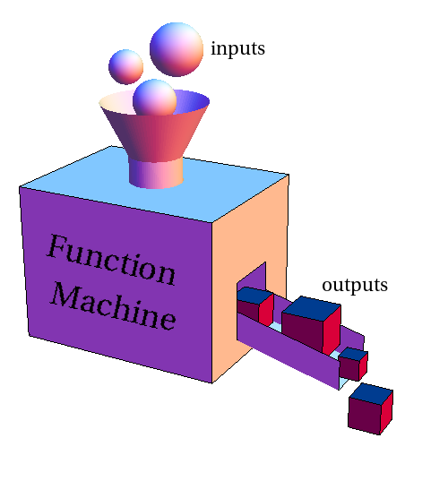
Function
A function is a block of organized, reusable code that is used to perform a single, related action. Functions provide better modularity for your application and a high degree of code reusing.
As you already know, Python gives you many built-in functions like print(), etc. but you can also create your own functions. These functions are called user-defined functions.

Slide 3
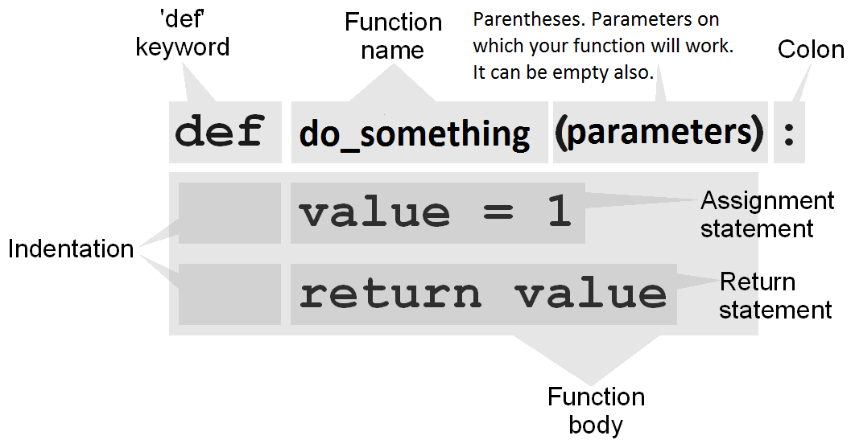
Defining a Function

Slide 4
Defining a Function
Function blocks begin with the keyword def followed by the function name and parentheses ( ) .
Any input parameters or arguments should be placed within these parentheses. You can also define parameters inside these parentheses.
The first statement of a function can be an optional statement - the documentation string of the function or docstring.
The code block within every function starts with a colon : and is indented.
The statement return [expression] exits a function, optionally passing back an expression to the caller. A return statement with no arguments is the same as return None.

Slide 5
Calling a Function
def greet(name):
"""This function greets to
the person passed in as
parameter"""
print("Hello, " + name + ". Good morning!")
# How to call a function in python?
greet(“Volodymyr")
greet("Liubov")
>> Hello, Volodymyr. Good morning! # first call to the same function
>> Hello, Liubov. Good morning! # second call to the same function

Slide 6
Docstring
The first string after the function header is called the """ Docstring """ and is short for documentation string. It is used to explain in brief, what a function does.
We generally use triple quotes so that docstring can extend up to multiple lines. This string is available to us as __doc__ attribute of the function.
Syntax of Function
def function_name(parameters):
"""docstring"""
statement(s)
def greet(name):
"""This function greets to the person""" print("Hello, " + name + ". Good morning!")
>>> print(greet.__doc__)
This function greets to the person

Slide 7
Operator return
def my_sum(arg1, arg2):
total = arg1 + arg2
print("Inside the function : ", total)
return total
print("After operator the return “)
suma = my_sum(10, 20)
print("Outside the function : ", suma)
>> Inside the function : 30
>> Outside the function : 30
def my_print(str):
print(str)
temp = my_print("first call function!")
print(temp)
>> first call function!
>> None

Slide 8
Function Arguments
Required arguments
Keyword arguments
Default arguments
Variable-length arguments

Slide 9
Required arguments
def my_print(str):
print(str)
my_print("first call function!")
>> first call function!
def my_print(str):
print(str)
my_print()
Traceback (most recent call last):
File "temp.py", line 17, in <module>
my_print()
TypeError: my_print() takes exactly 1 argument (0 given)

Slide 10
Keyword arguments
def print_info(name, age):
print("Name: ", name)
print("Age: ", age)
print_info(age=30, name="Alex")
print("-" * 10)
print_info(30, "Alex")
>> Name: Alex
>> Age: 30
>> ----------
>> Name: 30
>> Age: Alex

Slide 11
Default arguments
def print_info(name, age=18):
print("Name: ", name)
print("Age: ", age)
print_info("Alex")
Print("-" * 10)
print_info("Ogi", 25)
>> Name: Alex
>> Age: 18
>> ----------
>> Name: Ogi
>> Age: 25

Slide 12
Variable-length arguments
def print_numbers(arg, *vartuple):
print("arg: ")
print(arg)
print("vartuple: ")
for var in vartuple:
print(var)
print_numbers(10)
print("-" * 10)
print_numbers(70, 60, 50, 40)
>> arg:
>> 10
>> vartuple:
>> ----------
>> arg:
>> 70
>> vartuple:
>> 60
>> 50
>> 40

Slide 13
Scope and Lifetime of variables
Scope of a variable is the portion of a program where the variable is recognized. Parameters and variables defined inside a function is not visible from outside. Hence, they have a local scope.
Lifetime of a variable is the period throughout which the variable exits in the memory. The lifetime of variables inside a function is as long as the function executes.
They are destroyed once we return from the function. Hence, a function does not remember the value of a variable from its previous calls.
def scope_func():
x = 10
print("Value inside function:", x)
x = 20
scope_func()
print("Value outside function:", x)
>>> Value inside function: 10
>>> Value outside function: 20

Slide 14
Global vs. Local variables
total = 0 # This is global variable.
def my_sum(arg1, arg2):
total = arg1 + arg2 # Here total is local variable.
print("Inside the function local total : ", total)
return total
my_sum(10, 20)
print("Outside the function global total : ", total)
>> Inside the function local total : 30
>> Outside the function global total : 0

Slide 15
Python Recursive Function
We know that in Python, a function can call other functions. It is even possible for the function to call itself. These type of construct are termed as recursive functions.
Factorial of a number is the product of all the integers from 1 to that number.
For example, the factorial of 6 (denoted as 6!) is 1*2*3*4*5*6 = 720
def calc_factorial(x):
if x == 1 or x==0:
return 1
else:
return x * calc_factorial(x-1)

Slide 16
Python Anonymous/Lambda Function
Anonymous function is a function that is defined without a name.
def keyword – for define normal function.
lambda keyword - for define anonymous functions.
Syntax of Lambda Function
Example of Lambda Function
lambda arguments: expression
double = lambda x: x * 2
print(double(5))
! Lambda functions can have any number of arguments but only one expression.
! The expression is evaluated and returned.

Slide 17

More questions ?

Slide 18
THANK YOU FOR ATTENTION

